Slide 1
Quaternions and 3D Rotation
Lukas Goodman

Slide 2
Agenda
Let’s Talk Waves
How Do We Rotate Things
Why Aren’t They Spinning Right?!
Quaternions

Slide 3
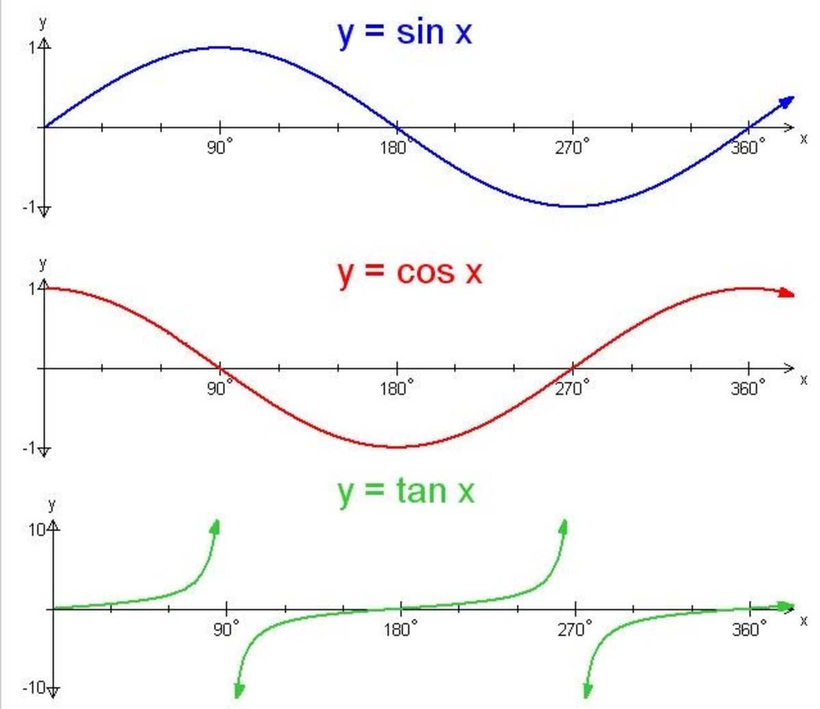
How Do We Rotate Stuff? Let’s Talk Waves
3 Functions:
Sin(θ)
Cos(θ)
Tan(θ)

Slide 4
Where do these functions come from though?

Slide 5
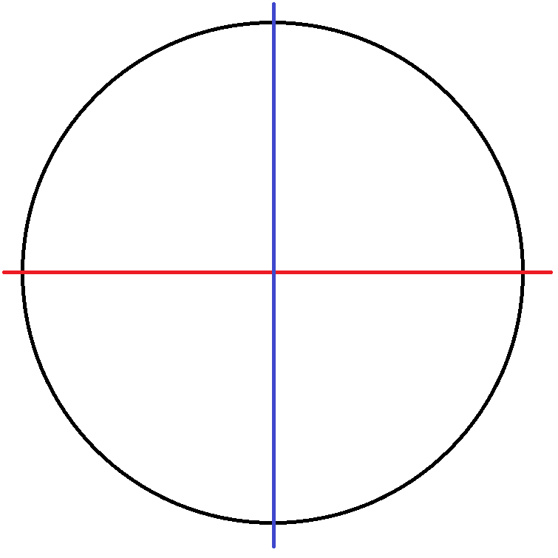
Unit Circle
(0,1)
(-1,0)
(1,0)
(0,-1)

Slide 6
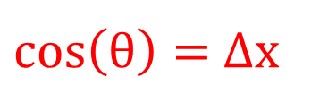
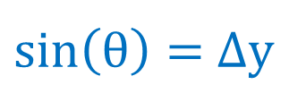
(0,1)
(-1,0)
(1,0)
(0,-1)
$\sin\left(θ\right)=$Δy
$\cos\left(θ\right)=$Δx

Slide 7
Credit Wikimedia Commons

Slide 8
We’ve got these functions but how do we use them to rotate stuff?

Slide 9
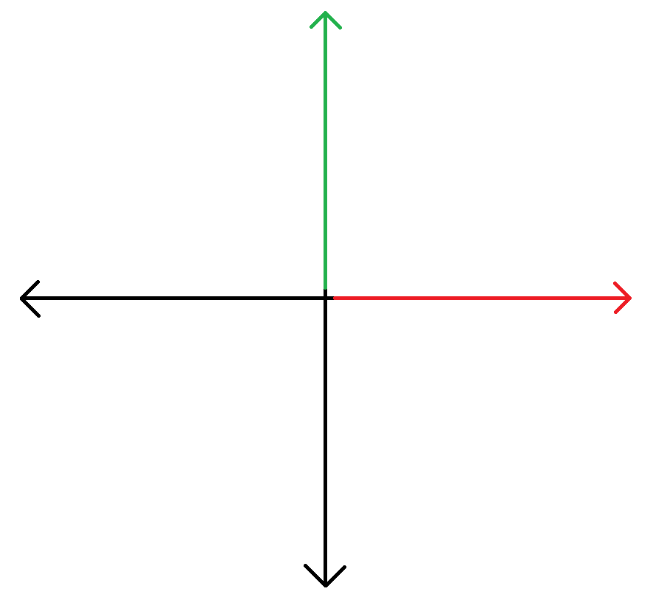

Slide 10
θ

Slide 11


$$cos\left(θ\right)$$
$$\sin\left(θ\right)$$
θ

Slide 12

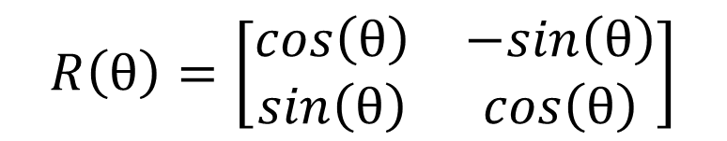

Ways To Rotate in 2 Dimensions
Matrices
Complex Numbers
$$R\left(θ\right)=\left[\begin{matrix}cos\left(θ\right) & −sin\left(θ\right) \\ sin\left(θ\right) & cos\left(θ\right)\end{matrix}\right]$$
$$r\left(θ\right)=cos\left(θ\right)+i\sin\left(θ\right)$$
$$i=\sqrt{−1}$$

Slide 13




Resulting Equations
Matrices
Complex Numbers
$$x_{f}=x_{i}cos{θ}−y_{i}sin{θ}$$
$$x_{f}=x_{i}cos{θ}−y_{i}sin{θ}$$
$$y_{f}=x_{i}sin{θ}+y_{i}cos{θ}$$
$$y_{f}=x_{i}sin{θ}+y_{i}cos{θ}$$

Slide 14
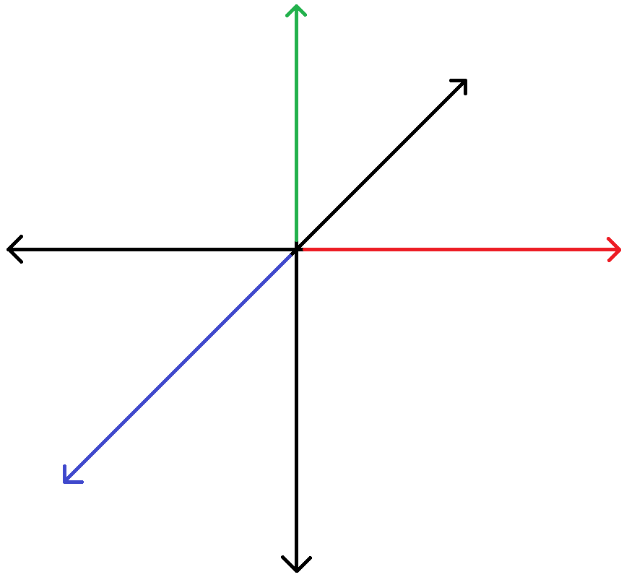

Slide 15

Ways To Rotate in 3 Dimensions
Matrices
$R_{z}\left(γ\right)=\left[\begin{matrix}\cos{(γ)} & −\sin{(γ)} & 0 \\ \sin{(γ)} & \cos{(γ)} & 0 \\ 0 & 0 & 1\end{matrix}\right]$ $R_{y}\left(β\right)=\left[\begin{matrix}\cos{(β)} & 0 & \sin{(β)} \\ 0 & 1 & 0 \\ −\sin{(β)} & 0 & \cos{(β)}\end{matrix}\right]$
$$R_{x}\left(α\right)=\left[\begin{matrix}1 & 0 & 0 \\ 0 & \cos{(α)} & −\sin{(α)} \\ 0 & \sin{(α)} & \cos{(α)}\end{matrix}\right]$$

Slide 16
Ways To Rotate in 3 Dimensions
Matrices
$${{ R}_{x}\left(α\right){ R}_{y}\left(β\right)R}_{z}\left(γ\right)=\left[\begin{matrix}\cos\left(α\right)\cos\left(β\right) & −\sin\left(β\right) & \sin\left(α\right)\cos\left(β\right) \\ \cos\left(α\right)\sin\left(β\right)\cos\left(γ\right)+\sin\left(α\right)\sin\left(γ\right) & \cos\left(β\right)\cos\left(γ\right) & \sin\left(α\right)\sin\left(β\right)\cos\left(γ\right)−\cos\left(α\right)\sin\left(γ\right) \\ \cos\left(α\right)\sin\left(β\right)\sin\left(γ\right)+\sin\left(α\right)\cos\left(γ\right) & \cos\left(β\right)\sin\left(γ\right) & \sin\left(α\right)\sin\left(β\right)\sin\left(γ\right)−\cos\left(α\right)\cos\left(β\right)\end{matrix} \right]$$

Slide 17
Resulting Equations
Matrices
$$x_{f}=x_{i}cos\left(α\right)cos⁡\left(β\right)−y_{i}sin\left(β\right)+z_{i}\sin\left(α\right)cos⁡\left(β\right)$$
$$y_{f}=$$
$$x_{i}\left(\cos\left(α\right)\sin\left(β\right)\cos\left(γ\right)+\sin\left(α\right)\sin\left(γ\right)\right)+y_{i}\left(\cos\left(β\right)\cos\left(γ\right)\right)+z_{i}(\sin\left(α\right)\sin\left(β\right)cos\left(γ\right)−\cos\left(α\right)sin\left(γ\right))$$
$$z_{f}=$$
$$x_{i}\left(\cos\left(α\right)\sin\left(β\right)\cos\left(γ\right)+\sin\left(α\right)\sin\left(γ\right)\right)+y_{i}\left(\cos\left(β\right)\cos\left(γ\right)\right)+z_{i}(\sin\left(α\right)\sin\left(β\right)cos\left(γ\right)−\cos\left(α\right)sin\left(γ\right))$$

Slide 18
Resulting Equations
Matrices
Complex Numbers
$$x_{f}=x_{i}cos{θ}−y_{i}sin{θ}$$
$$x_{f}=x_{i}cos{θ}−y_{i}sin{θ}$$
$$y_{f}=x_{i}sin{θ}+y_{i}cos{θ}$$
$$y_{f}=x_{i}sin{θ}+y_{i}cos{θ}$$

Slide 19
Resulting Equations
Matrices
$$x_{f}=x_{i}cos\left(α\right)cos⁡\left(β\right)−y_{i}sin\left(β\right)+z_{i}\sin\left(α\right)cos⁡\left(β\right)$$
$$y_{f}=$$
$$x_{i}\left(\cos\left(α\right)\sin\left(β\right)\cos\left(γ\right)+\sin\left(α\right)\sin\left(γ\right)\right)+y_{i}\left(\cos\left(β\right)\cos\left(γ\right)\right)+z_{i}(\sin\left(α\right)\sin\left(β\right)cos\left(γ\right)−\cos\left(α\right)sin\left(γ\right))$$
$$z_{f}=$$
$$x_{i}\left(\cos\left(α\right)\sin\left(β\right)\cos\left(γ\right)+\sin\left(α\right)\sin\left(γ\right)\right)+y_{i}\left(\cos\left(β\right)\cos\left(γ\right)\right)+z_{i}(\sin\left(α\right)\sin\left(β\right)cos\left(γ\right)−\cos\left(α\right)sin\left(γ\right))$$

Slide 20
Why Aren’t They Spinning Right?

Slide 21

Remember These?
Matrices
$R_{z}\left(γ\right)=\left[\begin{matrix}\cos{(γ)} & −\sin{(γ)} & 0 \\ \sin{(γ)} & \cos{(γ)} & 0 \\ 0 & 0 & 1\end{matrix}\right]$ $R_{y}\left(β\right)=\left[\begin{matrix}\cos{(β)} & 0 & \sin{(β)} \\ 0 & 1 & 0 \\ −\sin{(β)} & 0 & \cos{(β)}\end{matrix}\right]$
$$R_{x}\left(α\right)=\left[\begin{matrix}1 & 0 & 0 \\ 0 & \cos{(α)} & −\sin{(α)} \\ 0 & \sin{(α)} & \cos{(α)}\end{matrix}\right]$$

Slide 22
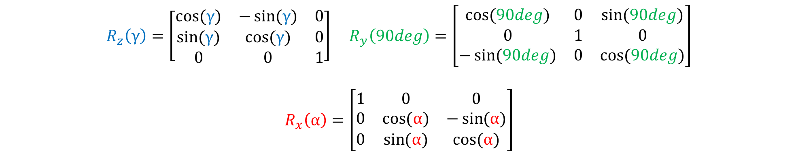
Remember These?
Matrices
$R_{z}\left(γ\right)=\left[\begin{matrix}\cos{(γ)} & −\sin{(γ)} & 0 \\ \sin{(γ)} & \cos{(γ)} & 0 \\ 0 & 0 & 1\end{matrix}\right]$ $R_{y}\left(90deg\right)=\left[\begin{matrix}\cos{(90deg)} & 0 & \sin{(90deg)} \\ 0 & 1 & 0 \\ −\sin{(90deg)} & 0 & \cos{(90deg)}\end{matrix}\right]$
$$R_{x}\left(α\right)=\left[\begin{matrix}1 & 0 & 0 \\ 0 & \cos{(α)} & −\sin{(α)} \\ 0 & \sin{(α)} & \cos{(α)}\end{matrix}\right]$$

Slide 23
It All Comes Down To This
Matrices
$$R_{z}\left(γ\right){ R}_{y}\left(β\right){ R}_{x}\left(α\right)=\left[\begin{matrix}0 & 0 & 1 \\ sin⁡(α+γ) & cos⁡(α+γ) & 0 \\ −cos⁡(α+γ) & sin⁡(α+γ) & 0\end{matrix} \right]$$

Slide 24
Ways To Rotate in 3 Dimensions
Matrices
$$R_{z}\left(γ\right){ R}_{y}\left(β\right){ R}_{x}\left(α\right)=\left[\begin{matrix}\cos\left(α\right)\cos\left(β\right) & −\sin\left(β\right) & \sin\left(α\right)\cos\left(β\right) \\ \cos\left(α\right)\sin\left(β\right)\cos\left(γ\right)+\sin\left(α\right)\sin\left(γ\right) & \cos\left(β\right)\cos\left(γ\right) & \sin\left(α\right)\sin\left(β\right)\cos\left(γ\right)−\cos\left(α\right)\sin\left(γ\right) \\ \cos\left(α\right)\sin\left(β\right)\sin\left(γ\right)+\sin\left(α\right)\cos\left(γ\right) & \cos\left(β\right)\sin\left(γ\right) & \sin\left(α\right)\sin\left(β\right)\sin\left(γ\right)−\cos\left(α\right)\cos\left(β\right)\end{matrix} \right]$$

Slide 25
It All Comes Down To This
Matrices
$$R_{z}\left(γ\right){ R}_{y}\left(β\right){ R}_{x}\left(α\right)=\left[\begin{matrix}0 & 0 & 1 \\ sin⁡(α+γ) & cos⁡(α+γ) & 0 \\ −cos⁡(α+γ) & sin⁡(α+γ) & 0\end{matrix} \right]$$

Slide 26


Ways To Rotate in 3 Dimensions
Complex Numbers: Quaternions
$$i,j,k=\sqrt{−1}$$
$Q=t+ix+jy+kz$

Slide 27

Ways To Rotate in 3 Dimensions
Complex Numbers: Quaternions
$R_{z}=\cos\left(\frac{γ}{2}\right)+C\sin\left(\frac{γ}{2}\right)$ $R_{y}=\cos\left(\frac{β}{2}\right)+B\sin\left(\frac{β}{2}\right)$
$$R_{x}=\cos\left(\frac{α}{2}\right)+A\sin\left(\frac{α}{2}\right)$$

Slide 28
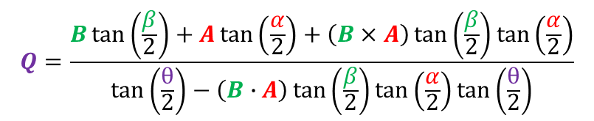

Ways To Rotate in 3 Dimensions
Complex Numbers: Quaternions
$$R_{x}R_{y}=R_{Q}=\cos\left(\frac{θ}{2}\right)+Q\sin\left(\frac{θ}{2}\right)$$
θ $=2\cos^{−1}\left(\cos\left(\frac{β}{2}\right)\cos\left(\frac{α}{2}\right)−\left(B∙A\right)\sin\left(\frac{β}{2}\right)\sin\left(\frac{α}{2}\right)\right)$
$$Q=\frac{B\tan\left(\frac{β}{2}\right)+A\tan\left(\frac{α}{2}\right)+\left(B×A\right)\tan\left(\frac{β}{2}\right)\tan\left(\frac{α}{2}\right)}{\tan\left(\frac{θ}{2}\right)−\left(B∙A\right)\tan\left(\frac{β}{2}\right)\tan\left(\frac{α}{2}\right)\tan\left(\frac{θ}{2}\right)}$$

Slide 29
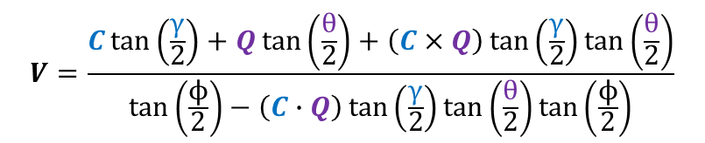

Ways To Rotate in 3 Dimensions
Complex Numbers: Quaternions
$$R_{Q}R_{z}=R_{f}=\cos\left(\frac{ϕ}{2}\right)+V\sin\left(\frac{ϕ}{2}\right)$$
ϕ $=2\cos^{−1}\left(\cos\left(\frac{γ}{2}\right)\cos\left(\frac{θ}{2}\right)−\left(C∙Q\right)\sin\left(\frac{γ}{2}\right)\sin\left(\frac{θ}{2}\right)\right)$
$$V=\frac{C\tan\left(\frac{γ}{2}\right)+Q\tan\left(\frac{θ}{2}\right)+\left(C×Q\right)\tan\left(\frac{γ}{2}\right)\tan\left(\frac{θ}{2}\right)}{\tan\left(\frac{ϕ}{2}\right)−\left(C∙Q\right)\tan\left(\frac{γ}{2}\right)\tan\left(\frac{θ}{2}\right)\tan\left(\frac{ϕ}{2}\right)}$$

Slide 30
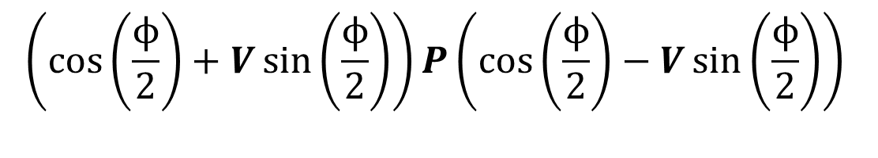
Ways To Rotate in 3 Dimensions
Complex Numbers: Quaternions
$$\left(\cos\left(\frac{ϕ}{2}\right)+V\sin\left(\frac{ϕ}{2}\right)\right)P\left(\cos\left(\frac{ϕ}{2}\right)−V\sin\left(\frac{ϕ}{2}\right)\right)$$

Slide 31
Questions?

Slide 32
Thank you
Lukas Goodman

